Slide 1
COMP 472
Mini-project Presentation
Team SandwichAI

Slide 2
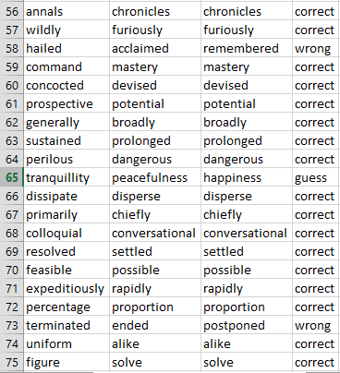
Details for [word2vec-google-news-300]

Slide 3
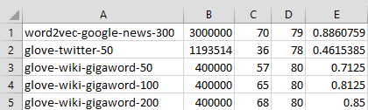
analysis.csv (after running Task 2)

Slide 4
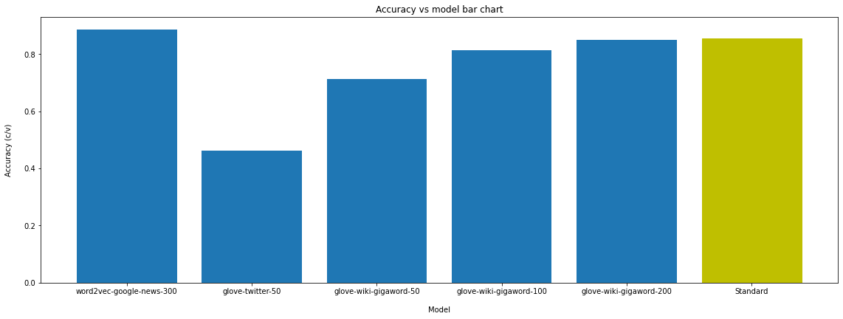
Measuring the accuracy of each model
Back to the code

Slide 5
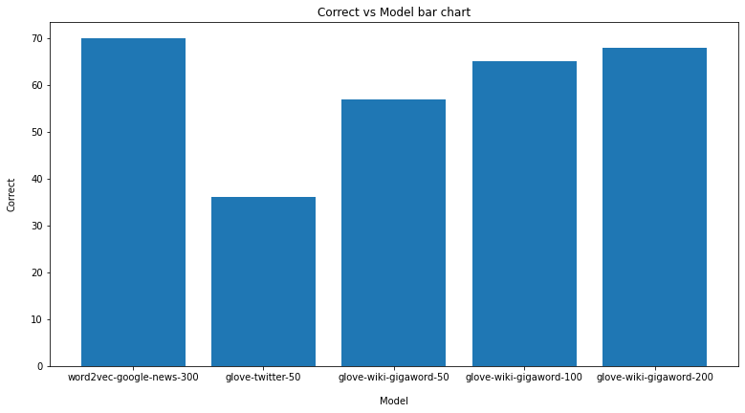
Number of correct answers for each model

Slide 6
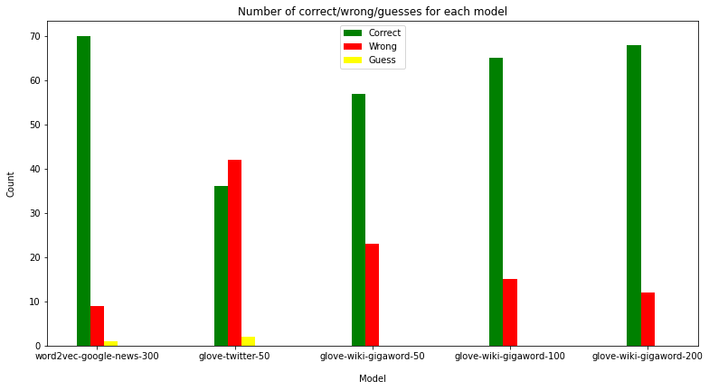
Number of correct/wrong/guesses for each model

Slide 7
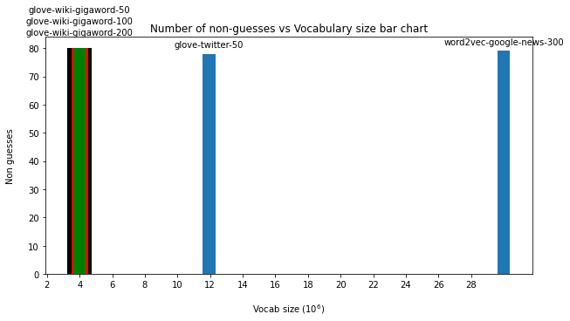
Number of non guesses vs the vocabulary size

Slide 8
The end

